Slide 1

Capstone Project – 4
NETFLIX Movies and TV Shows
Clustering
Submitted By:
Jyoti Singh

Slide 2


Problem Statement
In2018 NETFLIX released an interesting report which shows that the number of TV
shows on Netflix has nearly tripled since 2010. The streaming service’s number of
movies has decreased by more than 2,000 titles since 2010, while its number of
TV shows has nearly tripled. It will be interestingly to explore what all other insights
can be obtained from the same dataset.
Main Purpose of this project is to do EDA, NETFLIX’s recent year focus , understanding what
type of content available on NETFLIX and Clustering similar content by using text based features.

Slide 3

Objectives
To learn how real time data is represented in dataset
To understand how to preprocess such data
To fit various models such as Kmeans(Silhouette score, Elbow Method,
Hierarchical Clustering, Agglomerative Cluster,Principal Component Cluster

Slide 4

Proposed Methodology
Clean data
Fetch and analyzed data
Building a cluster model
Validate the model
Predict values for the test data
Remove Missing Data
Create new features
Split Data

Slide 5


Data Description
The dataset contains 7787 rows and 12 columns , below are the features details:
Data | Data Type | Description
Show_id | Object | Unique ID for every Movie/TV Show
Type | Object | Identifier a Movie or a TV Show
Title | Object | Title of the Movie or a TV Show
director | Object | Director of the show
Cast | Object | Actor involved
country | Object | Country of prediction
Date_added | Object | Date it was added on NETFLIX

Slide 6
Data Description (Contd.)
Data | Data Type | Description
release_year | int | Actual release year of the show
Rating | Object | TV rating of the Show
Duration | Object | Total duration in minute or a season in TV show
Listed_in | Object | Genre
Description | Object | The summary description

Slide 7

Pre Processing and Data Cleaning
Duplicates Value: We searched for duplicates value but there were none duplicates in dataset.
Null Values: There were some null values in dataset
Extract new columns: Extracted rating_clean, international etc
Text Classification: remove punctuation, lower case, remove Stopwords,
Stemming, Tf-idf vectorization.

Slide 8
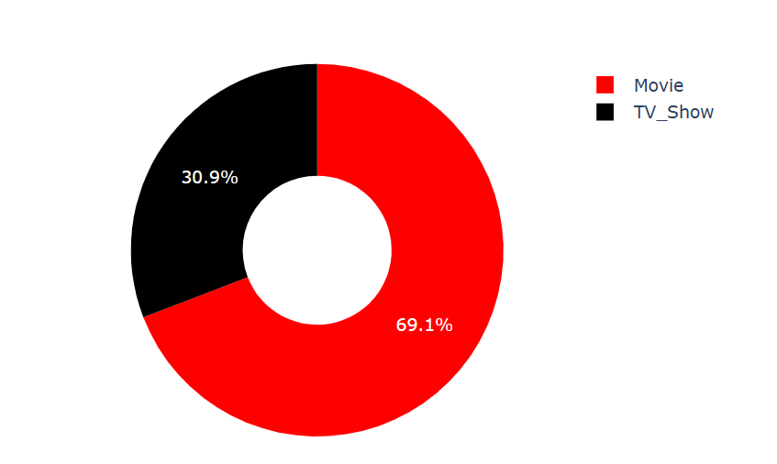
Exploratory Data Analysis
Value Count of Movies and TV Show
Netflix has 69% content of Movies
and 31% TV Shows.
It means Movie are popular rather
than TV Shows

Slide 9
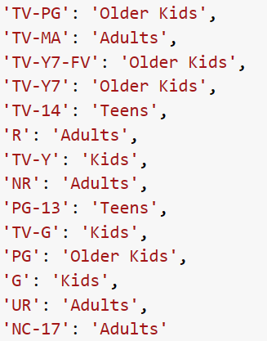
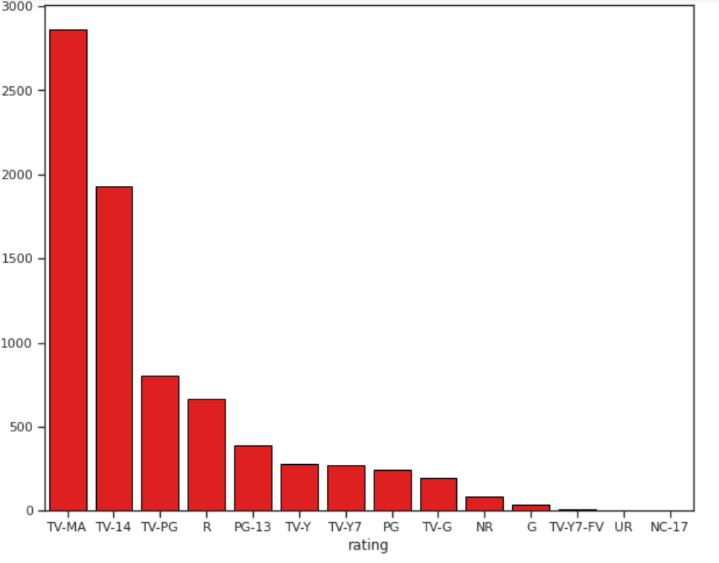
Rating of Movies and TV Shows by the Viewers
TV-MA is the most given rating then TV-14. That means most of the shows are for Adult.
After that movies content available for Teenager.

Slide 10
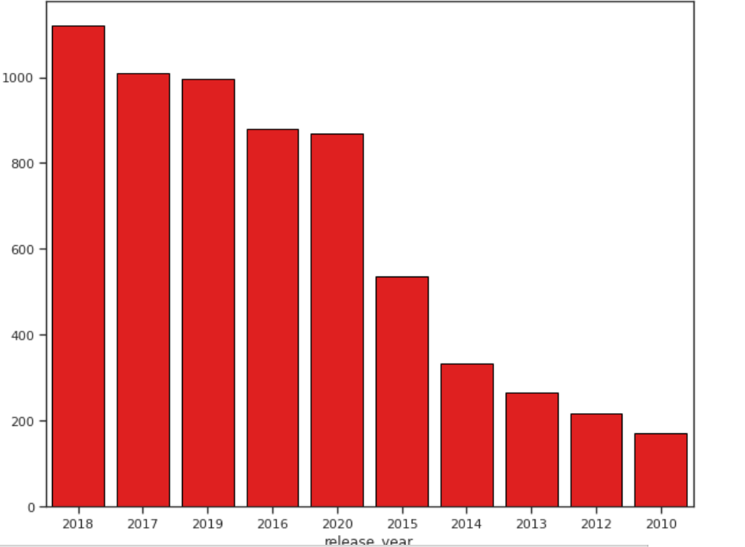
Movies and TV Shows releases year
Most of the show release in the year of 2018
After 2014 there are growth in the amount of content added

Slide 11
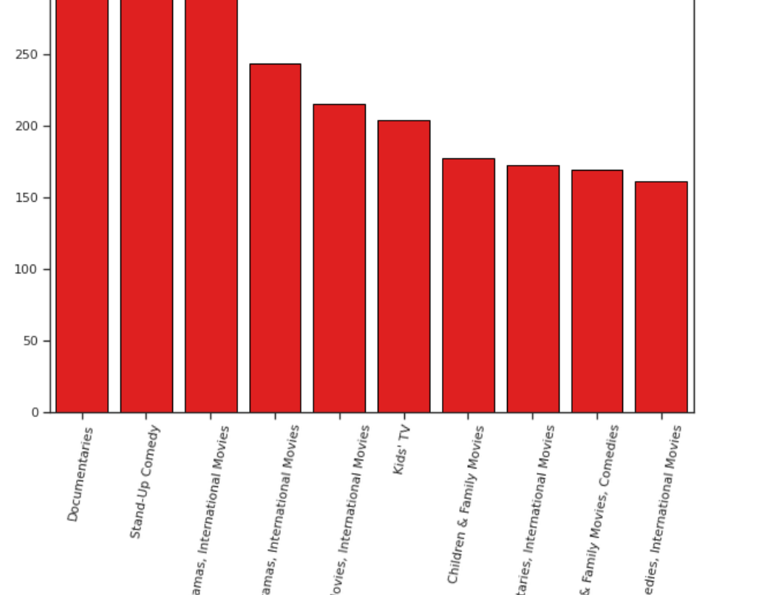
Top 10 Genre of Movies/TV Show on NETFLIX
The chart show that most of the show Genre related to Documentaries and Stand-Up Comedy.
After that Dramas and International Movies

Slide 12
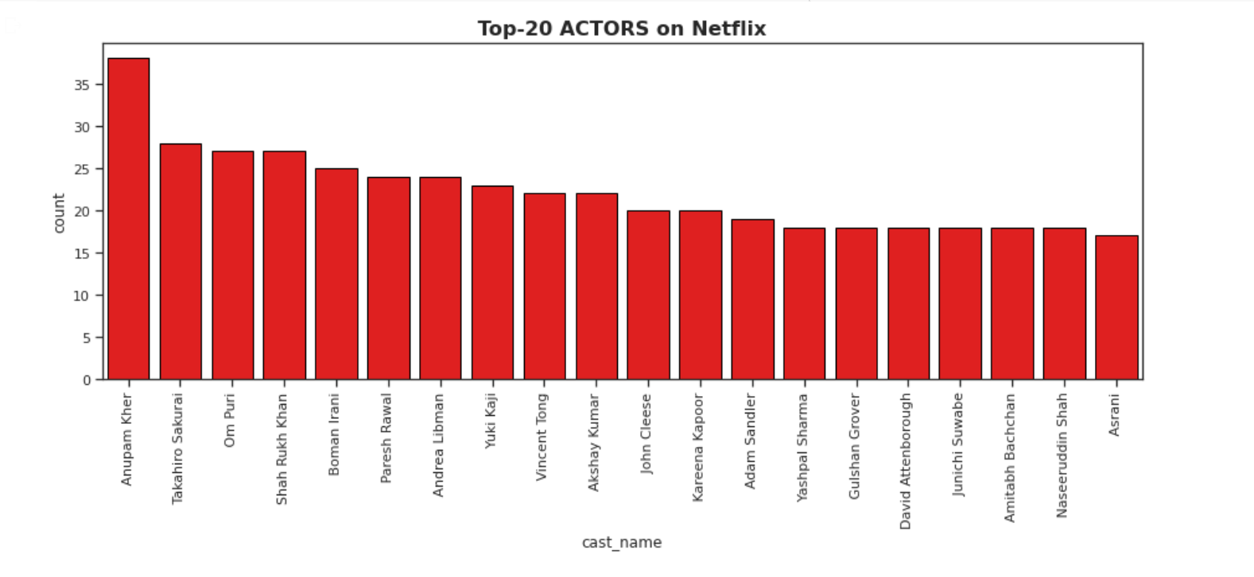
Top 20 actor with most number of Movies/Shows on Netflix
Anupam Kher, Takahiro Sakurai, Shah Rukh Khan, Om Puri, Boman Irani are among the top 5 actors worked on shows/movies on Netflix.

Slide 13
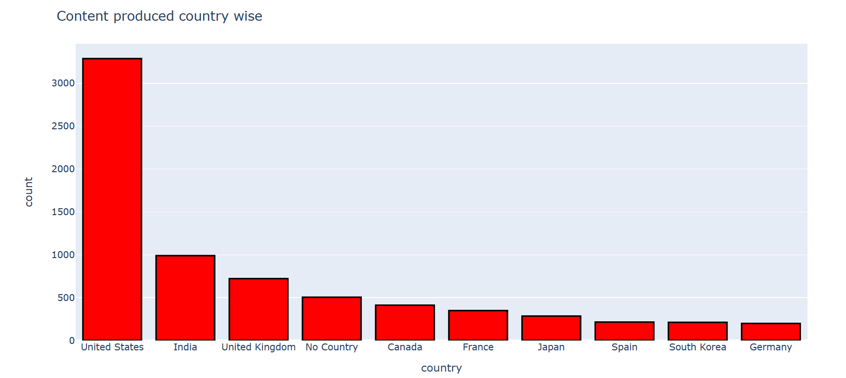
Which Country has most number of content
US and India has the most number of content after that United Kingdom

Slide 14
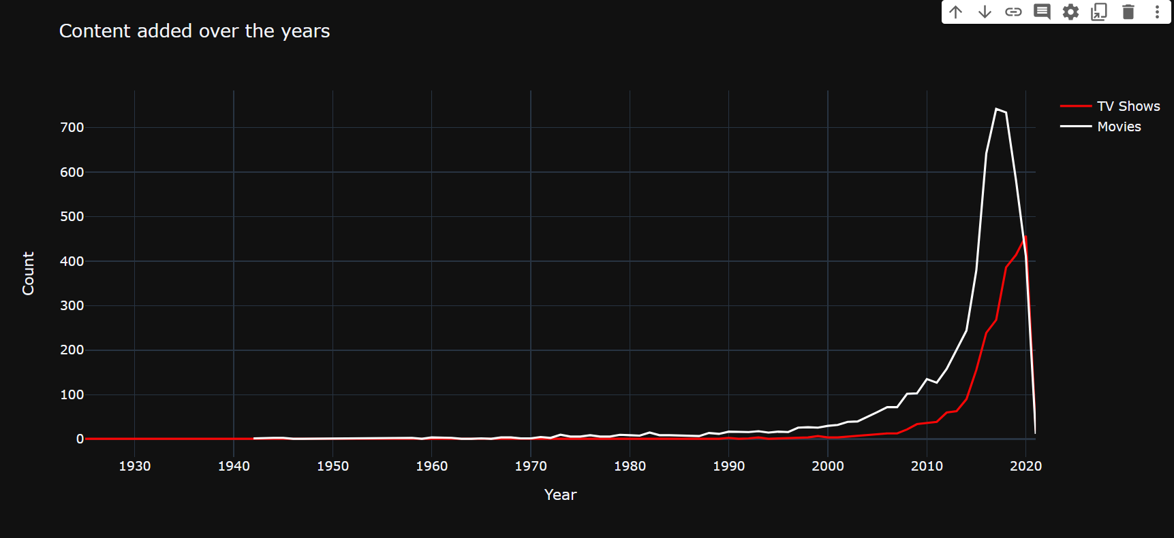
Content added over the year
Plot shos that people tend to rent bikes when the temperature is between -5 to 25 degrees.

Slide 15

Fitting various model
Silhouette Score(KMeans)
Elbow Method(Kmeans)
DBSCAN
Hierarchical Clustering
Agglomerative Clustering
Principal Component Analysis

Slide 16

Challenges Faced
● Comprehending the problem statement, and understanding the business implications.
● Feature engineering – deciding on which features to be dropped / kept / transformed
● Choosing the best visualization to show the trends among different features clearly in
the EDA phase
● Choosing the ML models to make Cluster for recommendation
● Choosing the best hyperparameters, which prevents overfitting
● Comprehending the problem statement, and understanding the

Slide 17

1. The dataset contains 7787 rows and 12 columns, cast and director columns have a lot of missing values so we dropped them and we have 10 features for the further analysis.
2. We have two types of content movies and TV shows.
3. Netflix has 69% of its content as movies, so we can say that movies are clearly more popular on Netflix than TV shows.
4. For mature audience, there is much more movie content than TV shows. However, for the younger audience (under the age of 17),there are more TV shows than movies.
5. Netflix has started adding content since 2014,highest number of movies and tv shows added in the year 2019,there is consistent content addition to netflix across the year.
6. The average duration of a movie on netflix is 90 minutes.
With respect to available content,the United States is on the top.India is at second followed by the UK and Canada. China is not even close to the top.

Slide 18
Cont…
7. In terms of genres, Dramas is on the top followed by Comedies and Documentaries.
8. Number of movies added to netflix is higher than that of TV shows. In 2019, netflix added 1497 movies and 656 TV shows. So there we cannot conclude that netflix has switched focus from movies to TV shows.
9. Principal component analysis was performed inorder to reduce the higher dimensionality which improved the silhouette coefficient to 0.34118. Clusters are identified for each of the record in the dataset.
10. Recommendation based on cosine similiarity is done.

Slide 19


